Slide 1
ASSIGNMENT 2
UAV
(UNMANNED AERIAL VEHICLE)
ROBOTIC HARDWARE (MCTE 4396)
Slide by: Al Saiaari Mohammed Nasser Saeed ( 1734429 )

Slide 2
01.
04.
History of UAV
PROPULSION
02.
05.
APPLICATIONS
NAVIGATION
03.
06.
AIRFRAME DESIGN
DATA COLLECTION
table of contents

Slide 3
01.
History of UAV

Slide 4
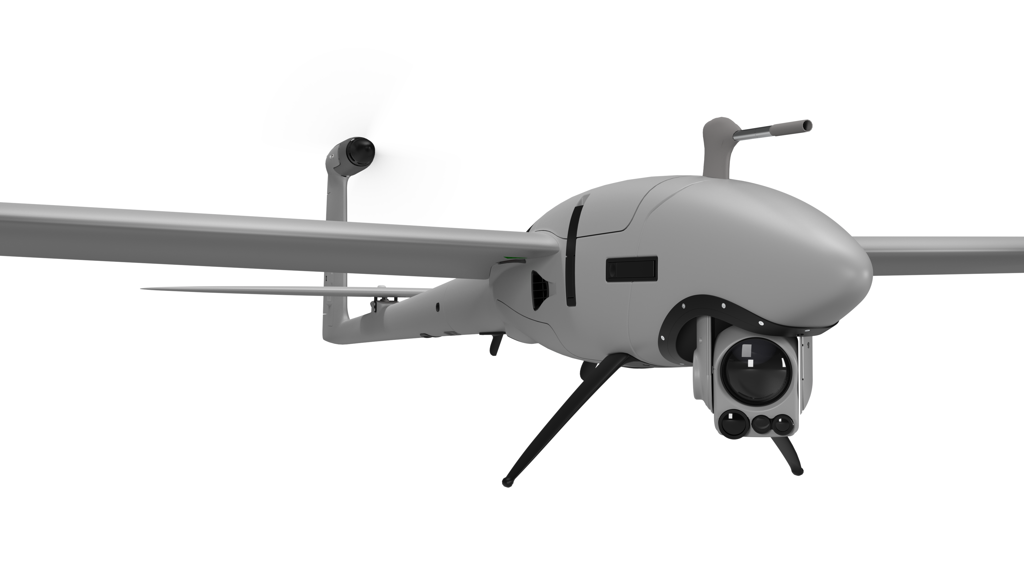
UAVs are being creatively used in several sectors, including construction and agriculture, for duties like crop monitoring and building inspections.
History of
UAV
Since 1917, when the US Navy developed the Kettering Bug, unmanned aerial vehicles (UAVs), sometimes known as drones, have been produced. After that, technologythe Predator drone is a good illustration of how technology behind them has advanced and been heavily utilised by the military throughout conflicts. UAVs are used for a variety of purposes nowadays, including commercial use and scientific research. With new advancements in autonomous flying, artificial intelligence, and sensors, technology is always evolving.
6

Slide 5
02.
APPLICATIONS

Slide 6
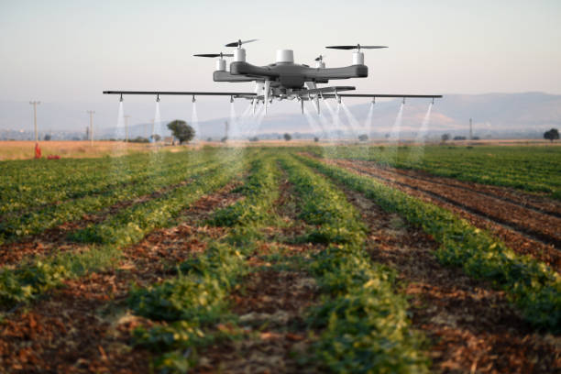
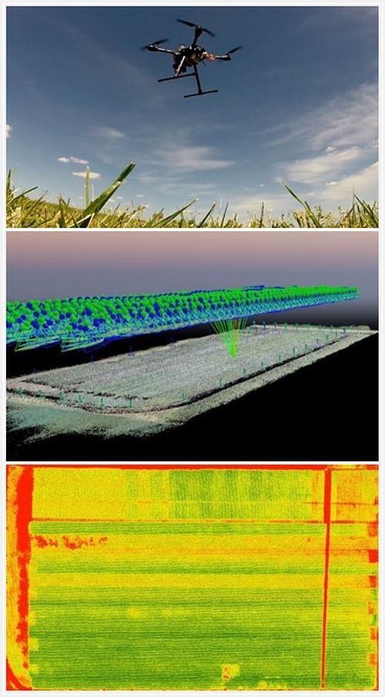
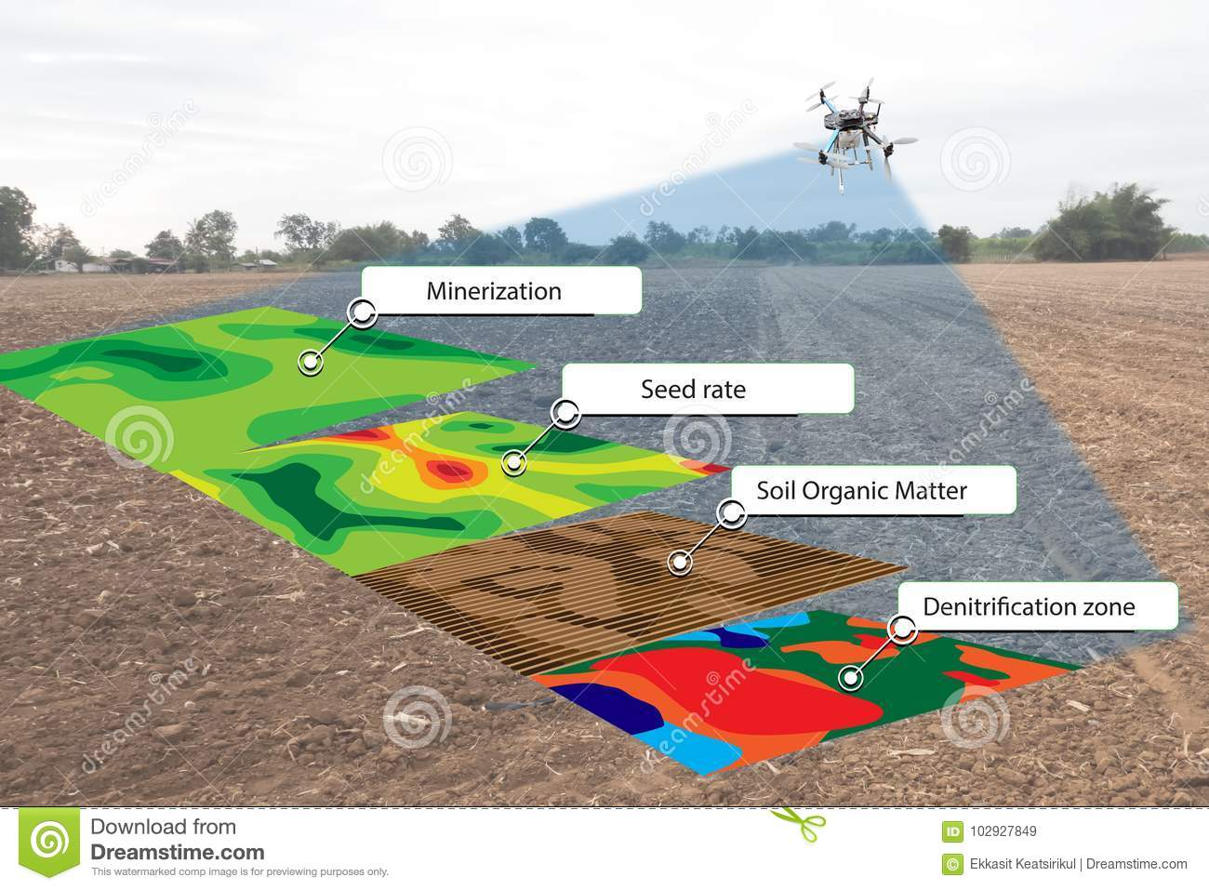
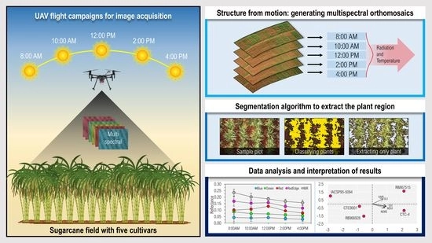
Agriculture
Data regarding crops and soil conditions may be gathered using UAVs with sensors and cameras. Crop yields can be increased by using this knowledge to improve agricultural methods.
CROP HEALTH
SOIL ANALYSIS
PEST AND DISEASE DETECTION
To increase crop productivity and use less water, UAVs can assess plant height, chlorophyll levels, and water stress.
UAVs can monitor soil moisture, temperature, and nutrients to improve the use of fertiliser and the condition of the soil.
Crop diseases and pests can be found by UAVs before they spread and reduce agricultural yield.

Slide 7
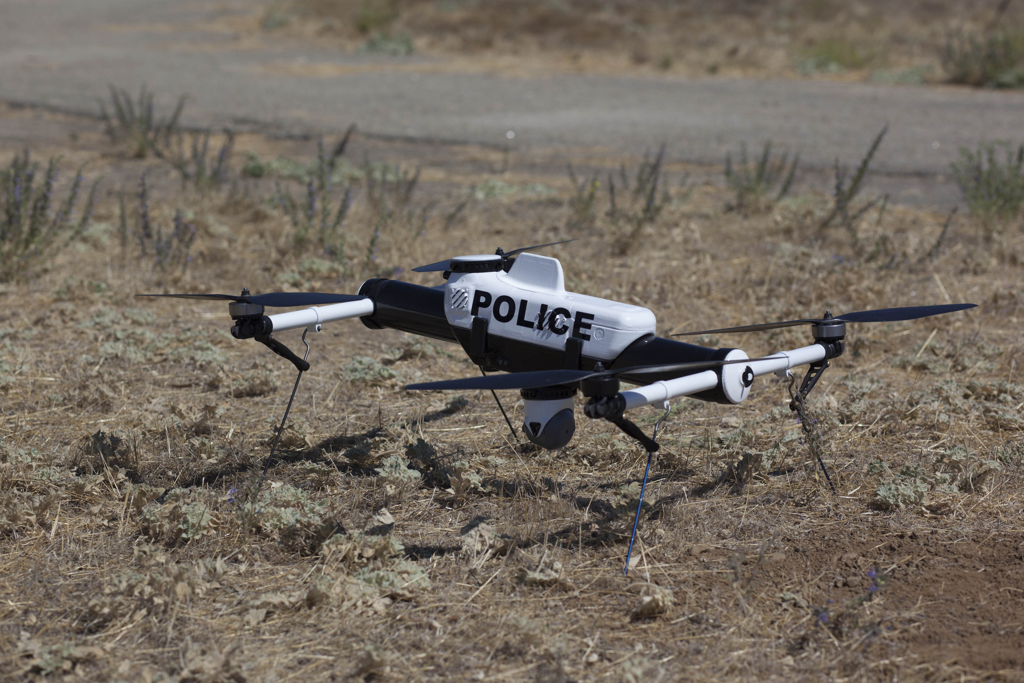
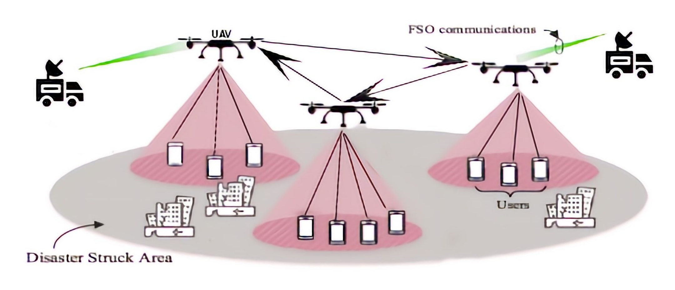
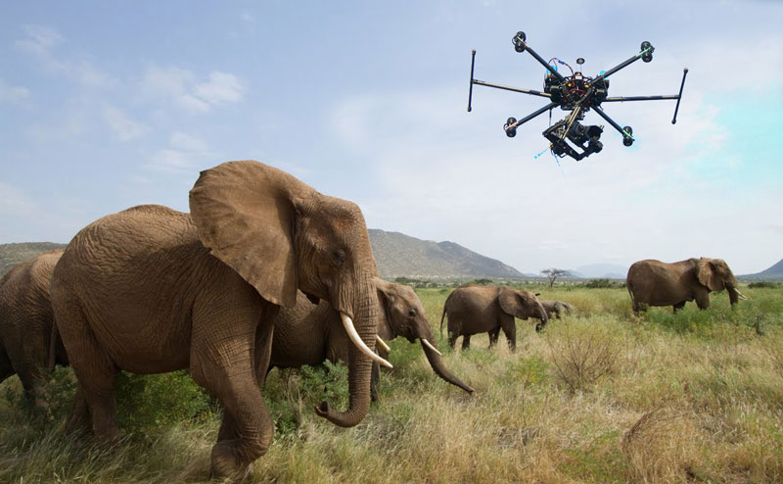
Search And Rescue
As they can access places that are challenging or hazardous for humans to visit, UAVs can be used to find victims or missing people in disaster zones.
DISASTER RESPONSE
WILDLIFE CONSERVATION
LAW ENFORCEMENT
By providing real-time data, UAVs can assist rescue teams in prioritising search efforts in earthquake, flood, and hurricane zones.
UAVs can identify and keep an eye on wildlife populations, providing information on animal behaviour and habitat use to conservation organisations.
UAVs can conduct real-time searches for missing individuals or criminal suspects, enhancing public safety.

Slide 8
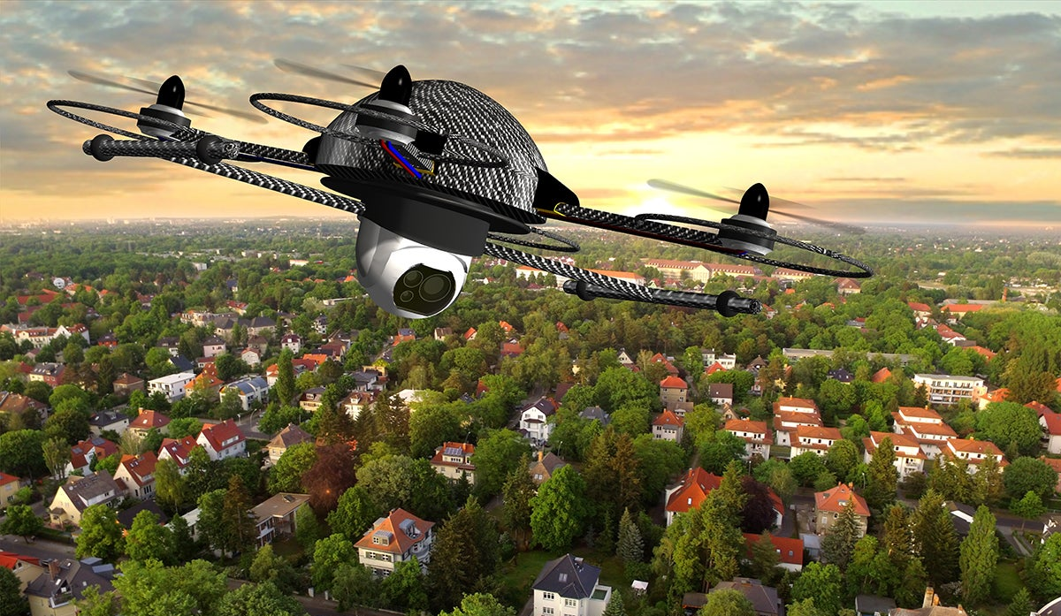
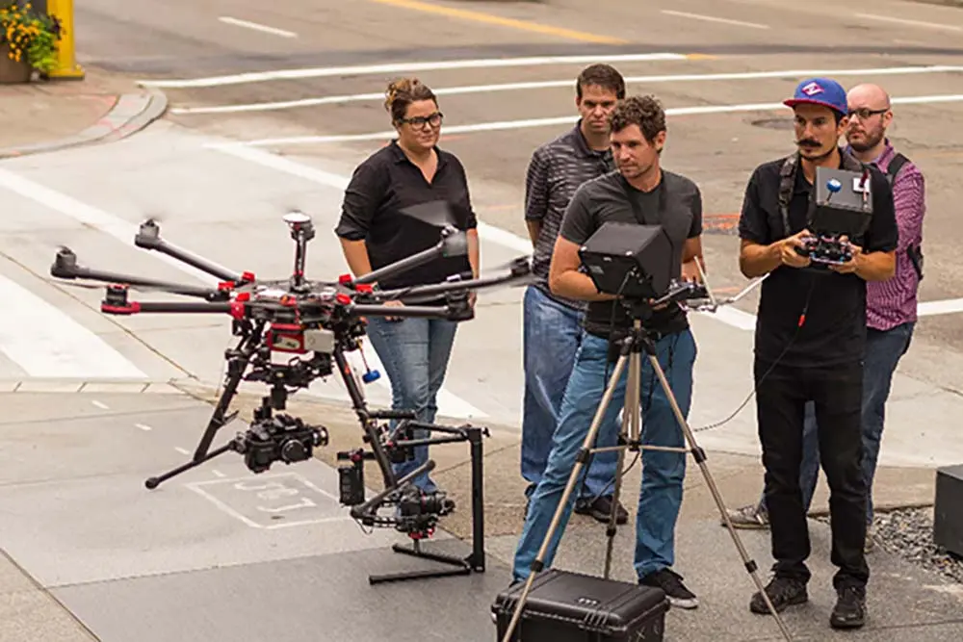
Aerial Photography and Videography
UAVs can take pictures and films in high definition from locations that are challenging to reach, like the air. This is particularly helpful for taking aerial pictures of landscapes, properties, and events.
REAL ESTATE
FILM AND TELEVISION
TOURISM
Take high-resolution pictures and videos of homes that are up for sale so that potential buyers may get a thorough impression of the property and its surroundings.
Aerial footage is used in movies, TV programmes, and advertisements to provide viewers a fresh viewpoint and improve the production's visual appeal.
tourist locations, offering them a distinctive perspective of the region and boosting tourism

Slide 9
03.
AIRFRAME DESIGN

Slide 10
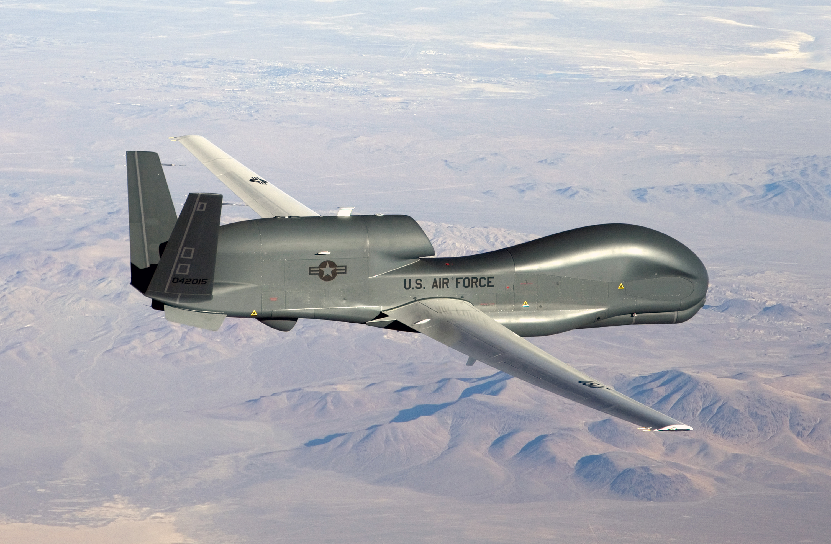
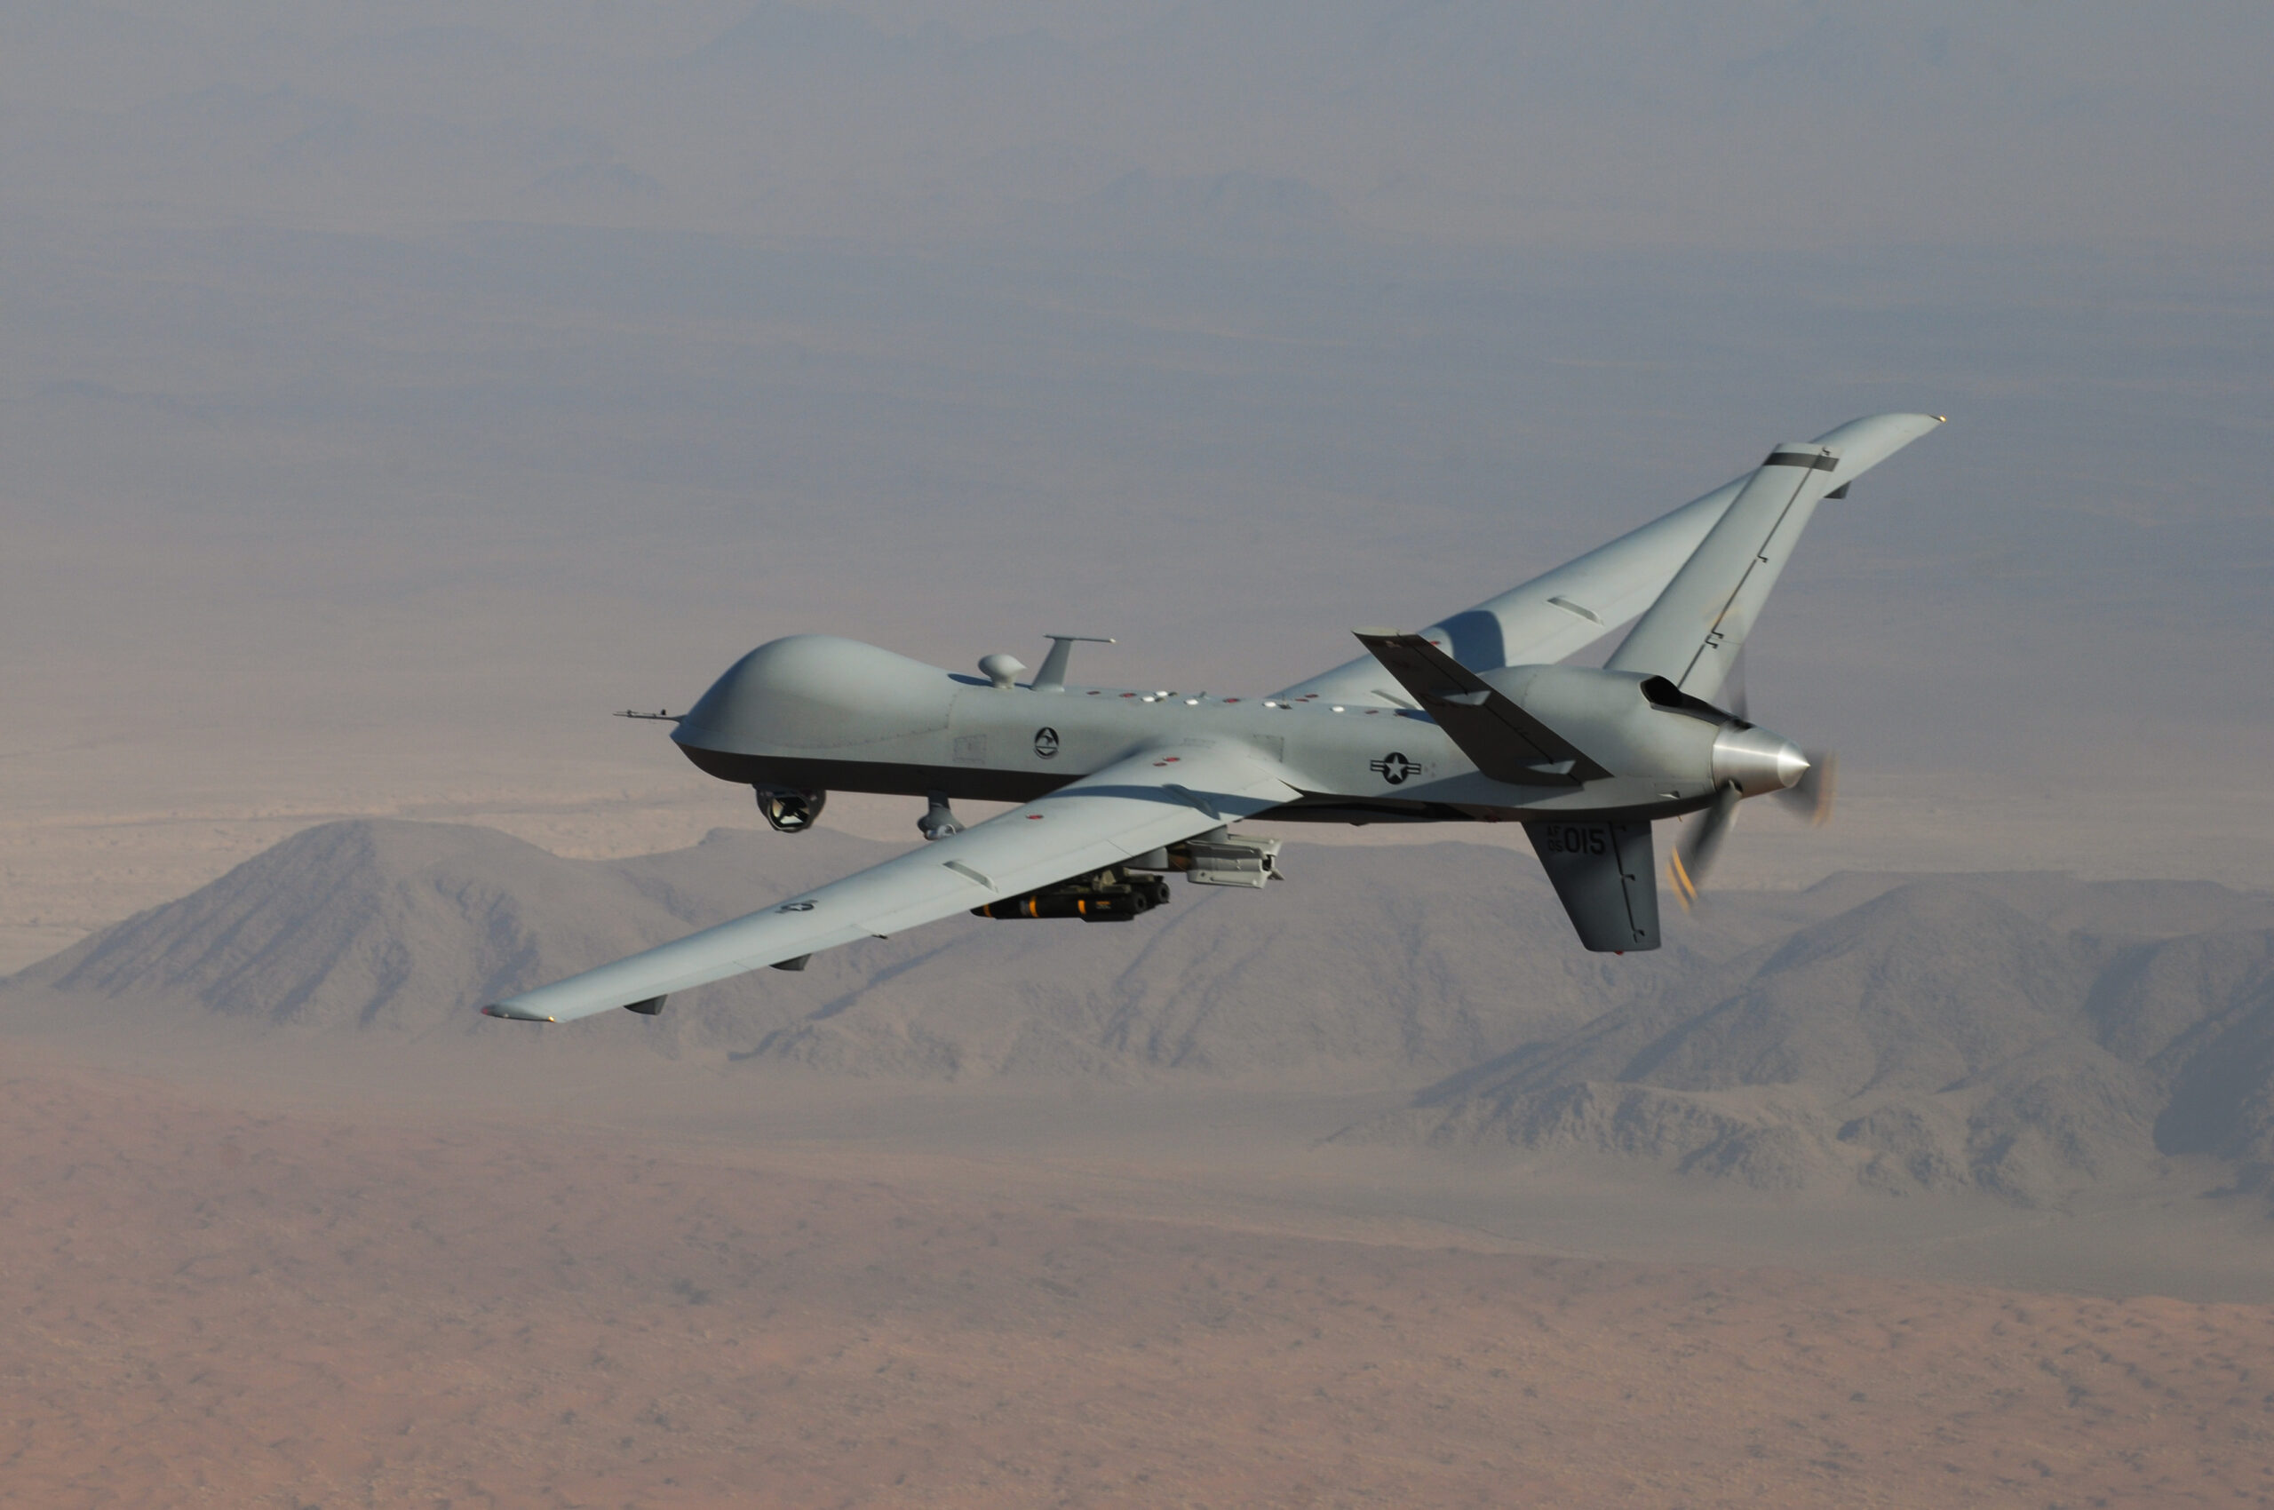
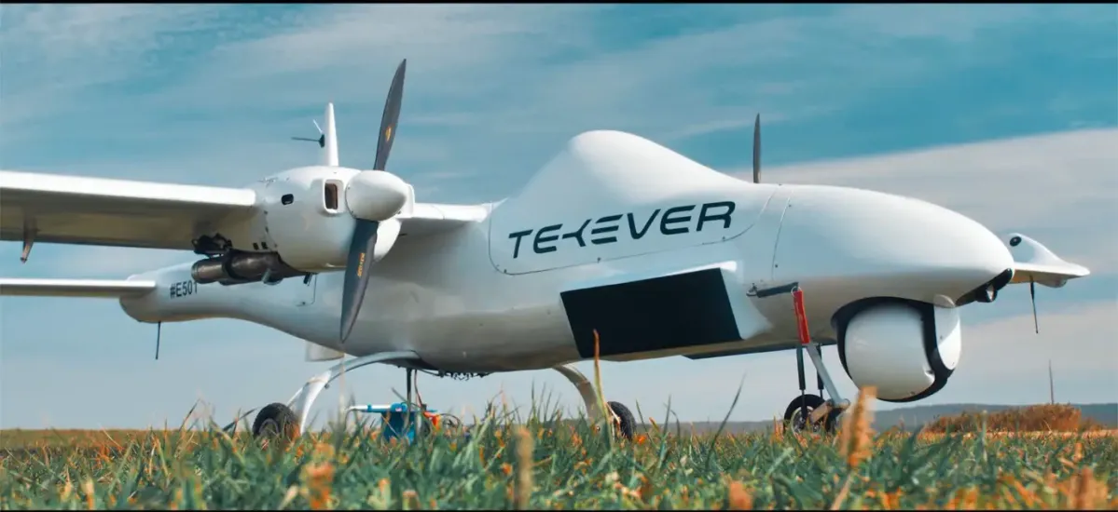
FIXED WING UAVS
REGULAR WINGS
LIGHT WEIGHT
LONG RANGE
Horizontal flight motion
RQ-4 Global Hawk
in order to maximise flying motion and decrease drag
TEKEVER AR4
The design primarily focuses on long-range surveillance
MQ-9 REAPER

Slide 11
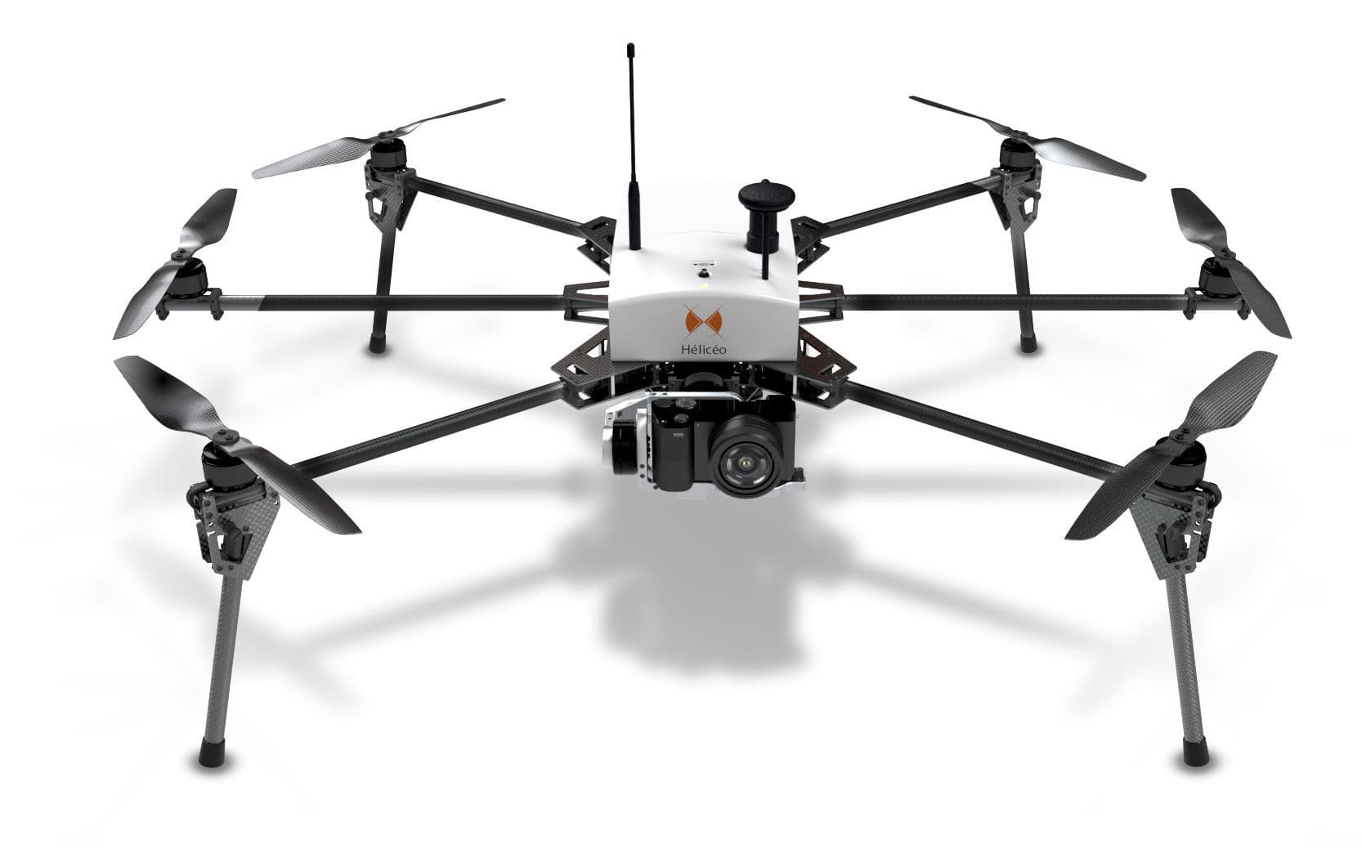
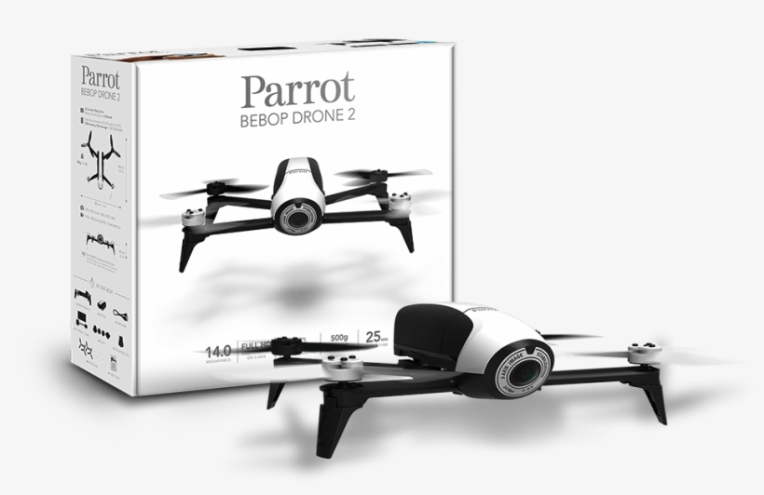
ROTARY-WING UAVS
SHORTER RANGE
VERTICAL LIFT-OFF
ROTARY WINGS
tasks with a shorter range, such search and rescue, inspection, and aerial photography
They are the best for operations in limited locations since they can take off and land vertically.
Use rotors to create lift and perform flying manoeuvres.
Quadcopters, helicopters
High mobility

Slide 12
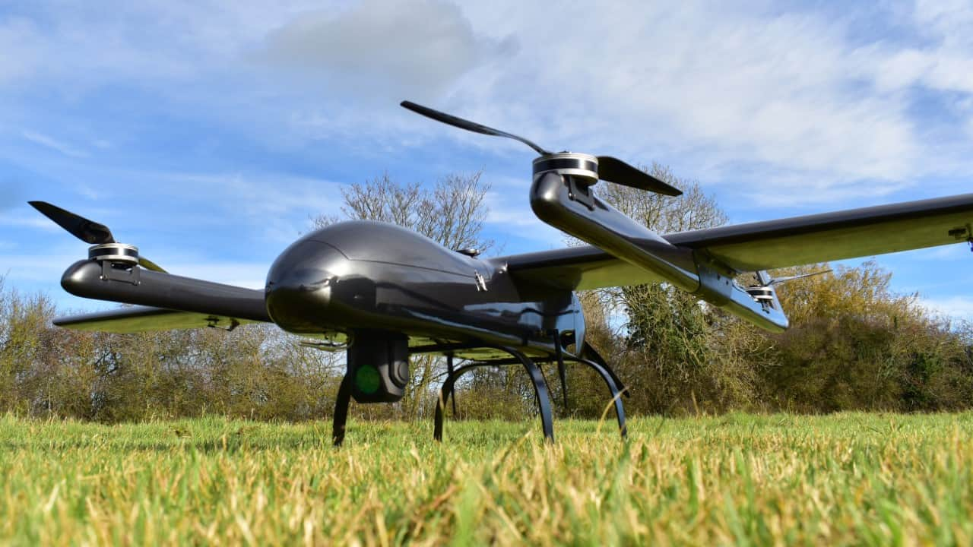
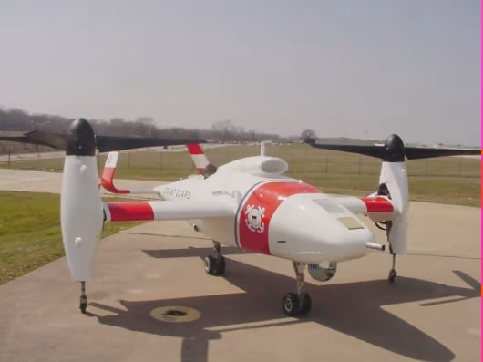
HYBRID UAVS
COMBINED FEATURES
HIGH MOBILITY
LONG RANGE
These unmanned aerial vehicles (UAVs) combine the advantages of rotary- and fixed-wing aircraft.
They have the ability to fly like a fixed-wing aircraft and can take off and land vertically like a helicopter.
Bell Eagle Eye
Handle large payloads like crop management in agriculture.

Slide 13
04.
PROPULSION

Slide 14
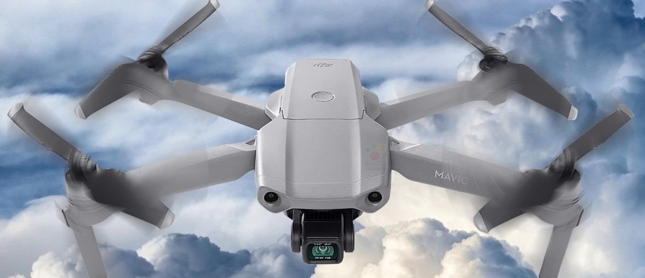
ELECTRIC PROPULSION
ADVANTAGES
HIGH MOBILITY
DISADVANTAGES
Appropriate for compact
lightweight UAVs less noisy than alternative propulsion systems
Limited range and endurance
Not be suitable for larger UAVs that

Slide 15
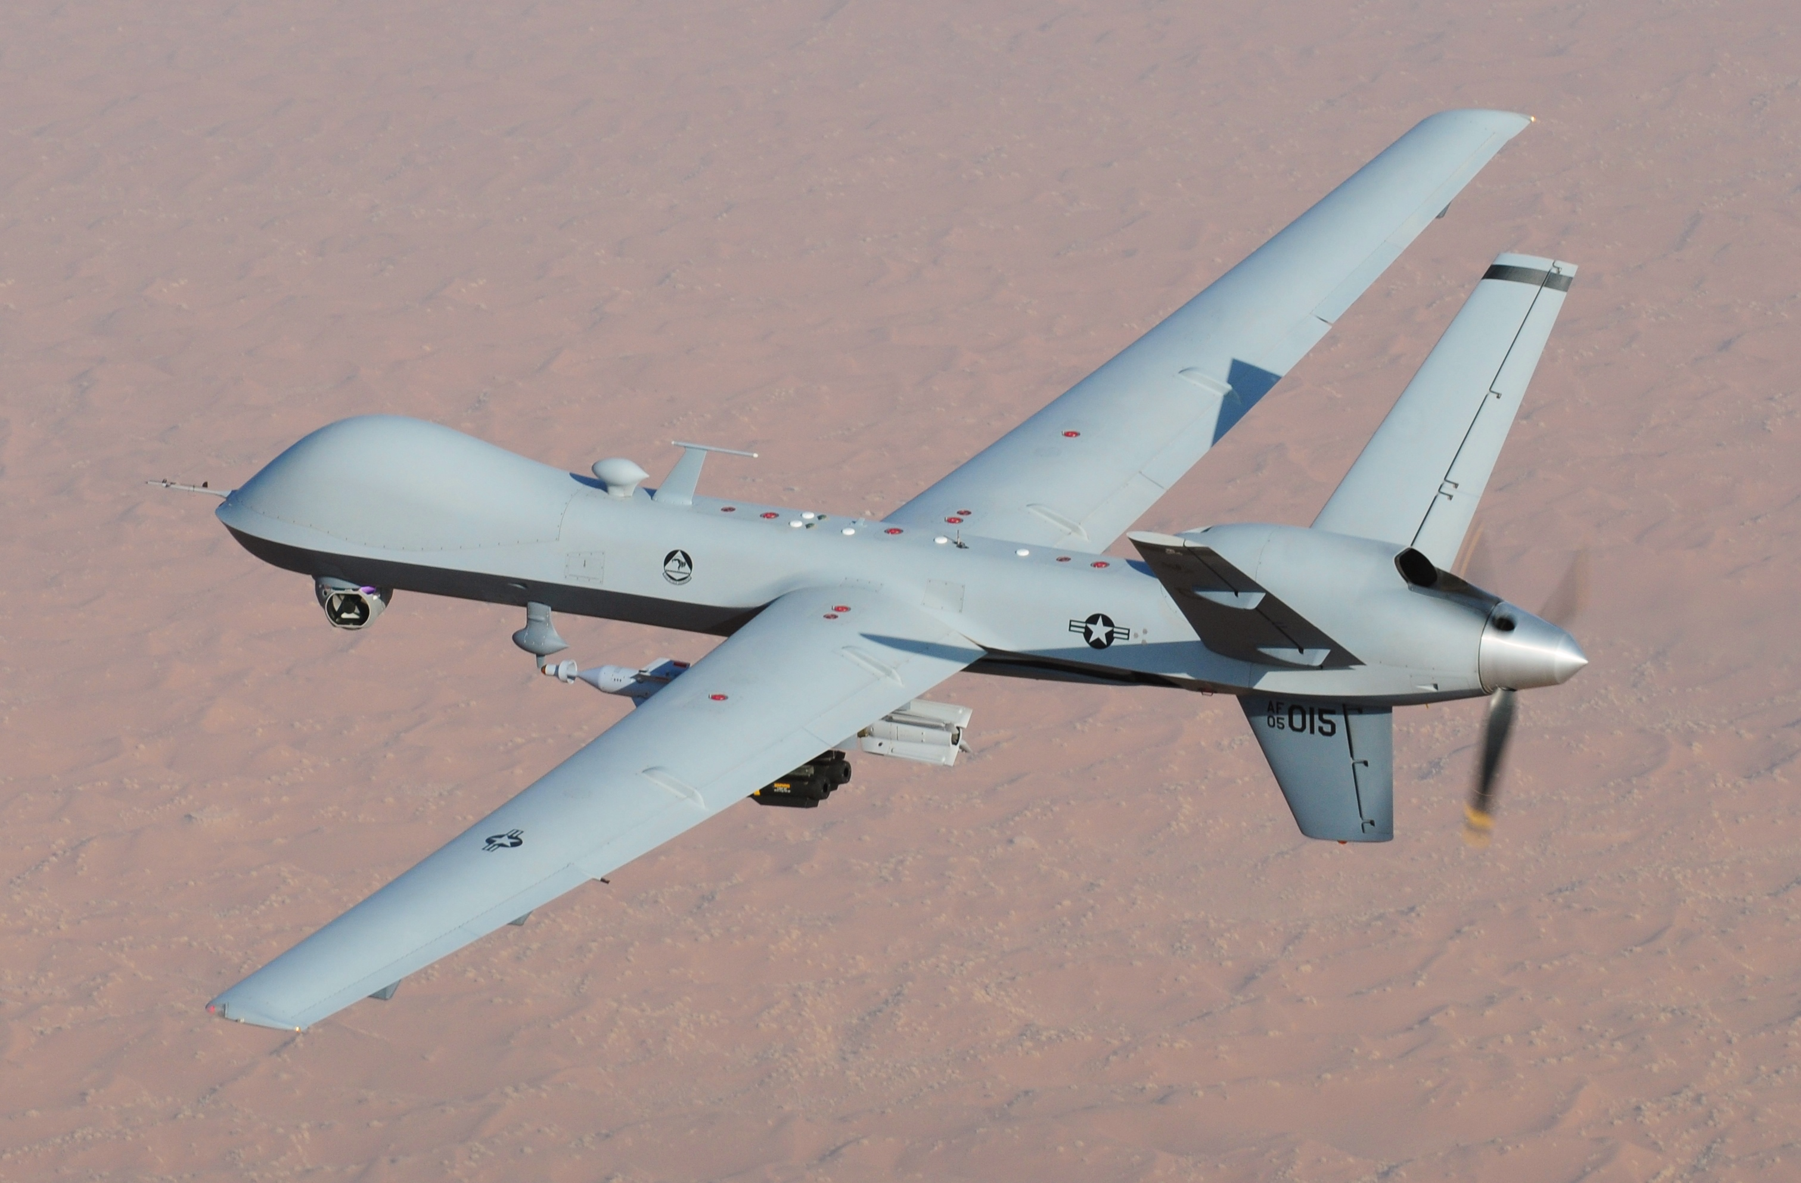
GASOLINE PROPULSION
ADVANTAGES
HIGH MOBILITY
DISADVANTAGES
Reliable and have been used in
aircraft for many years
Gasoline engines can be used to
power larger UAVs
Noisy and emit pollutants
Gasoline engines require regular
maintenance

Slide 16
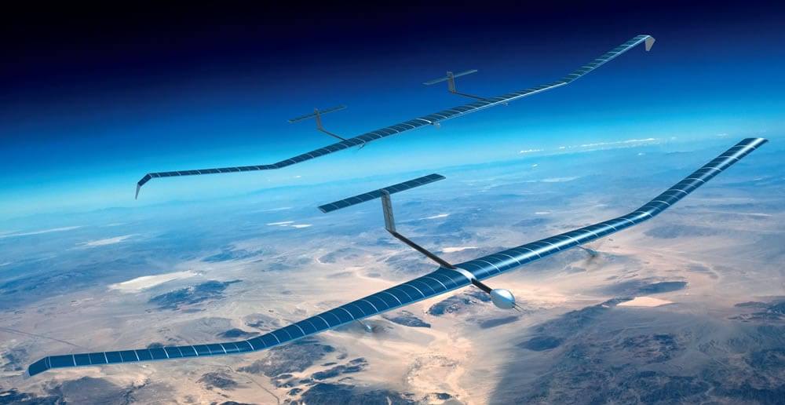
HYBRID PROPULSION
ADVANTAGES
HIGH MOBILITY
DISADVANTAGES
Hybrid propulsion systems can give the benefits of both electric and gasoline power systems
Designed to use a variety of fuels,
Complex operations require
specialized design and maintenance
Not be suitable for small UAVs that

Slide 17
05.
NAVIGATION

Slide 18
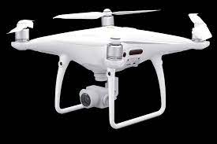
GPS NAVIGATION
HIGH MOBILITY
DJI Phantom 4 Pro: Uses GPS for navigation and autonomous flight modes, such as ActiveTrack and TapFlyDesigned to use a variety of fuels
General Atomics MQ-9 Reaper: Use GPS for navigation and features autonomous flight modes, such as automatic takeoff and landing

Slide 19
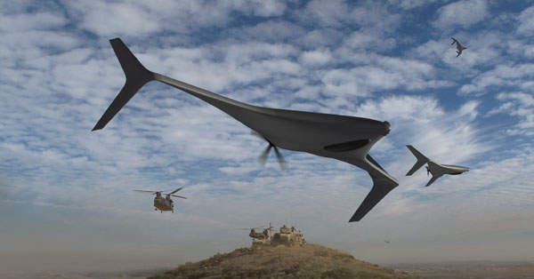
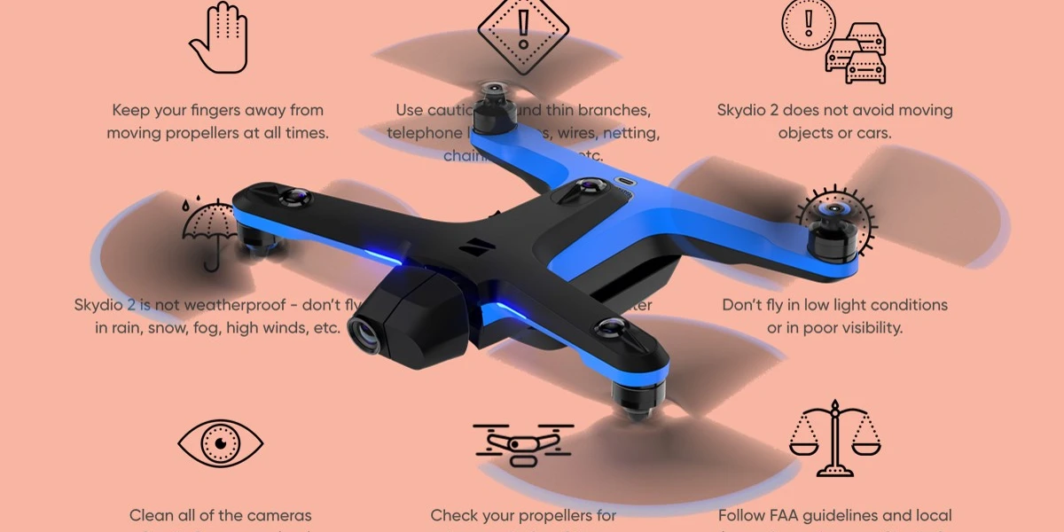
NON-GPS NAVIGATION
HIGH MOBILITY
Northrop Grumman Bat: Uses INS and Barometric Altimeters for navigation in GPS-denied conditions.
Skydio 2: computer vision and obstacle avoidance sensors for navigation

Slide 20
06.
DATA COLLECTION

Slide 21
DATA COLLECTION
HIGH MOBILITY
Cameras: The 12-megapixel RGB camera on the DJI Mavic 2 Enterprise Dual's dual-sensor camera system.
LiDAR: For topographic mapping, the RIEGL VUX-1 uses a high-precision LiDAR sensor that can be installed to a UAV.
Thermal Sensors: FLIR thermal camera with DJI Matrice 300 RTK.
Gyroscopes and accelerometers are used by the DJI Matrice 200 Series V2 to provide accurate flight control and navigation.
Magnetometer: For precise mapping and surveying tasks, the DJI Phantom 4 RTK employs a magnetometer.

Slide 22
07.
DATA TRANSMISSION

Slide 23
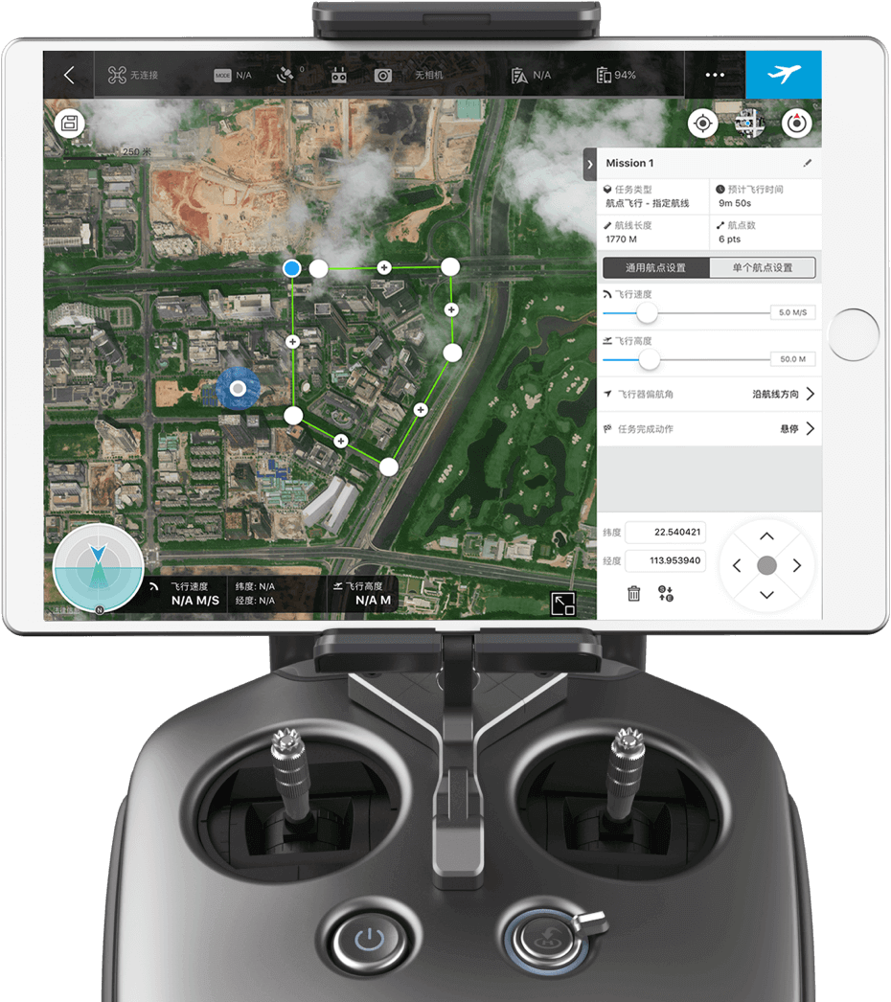
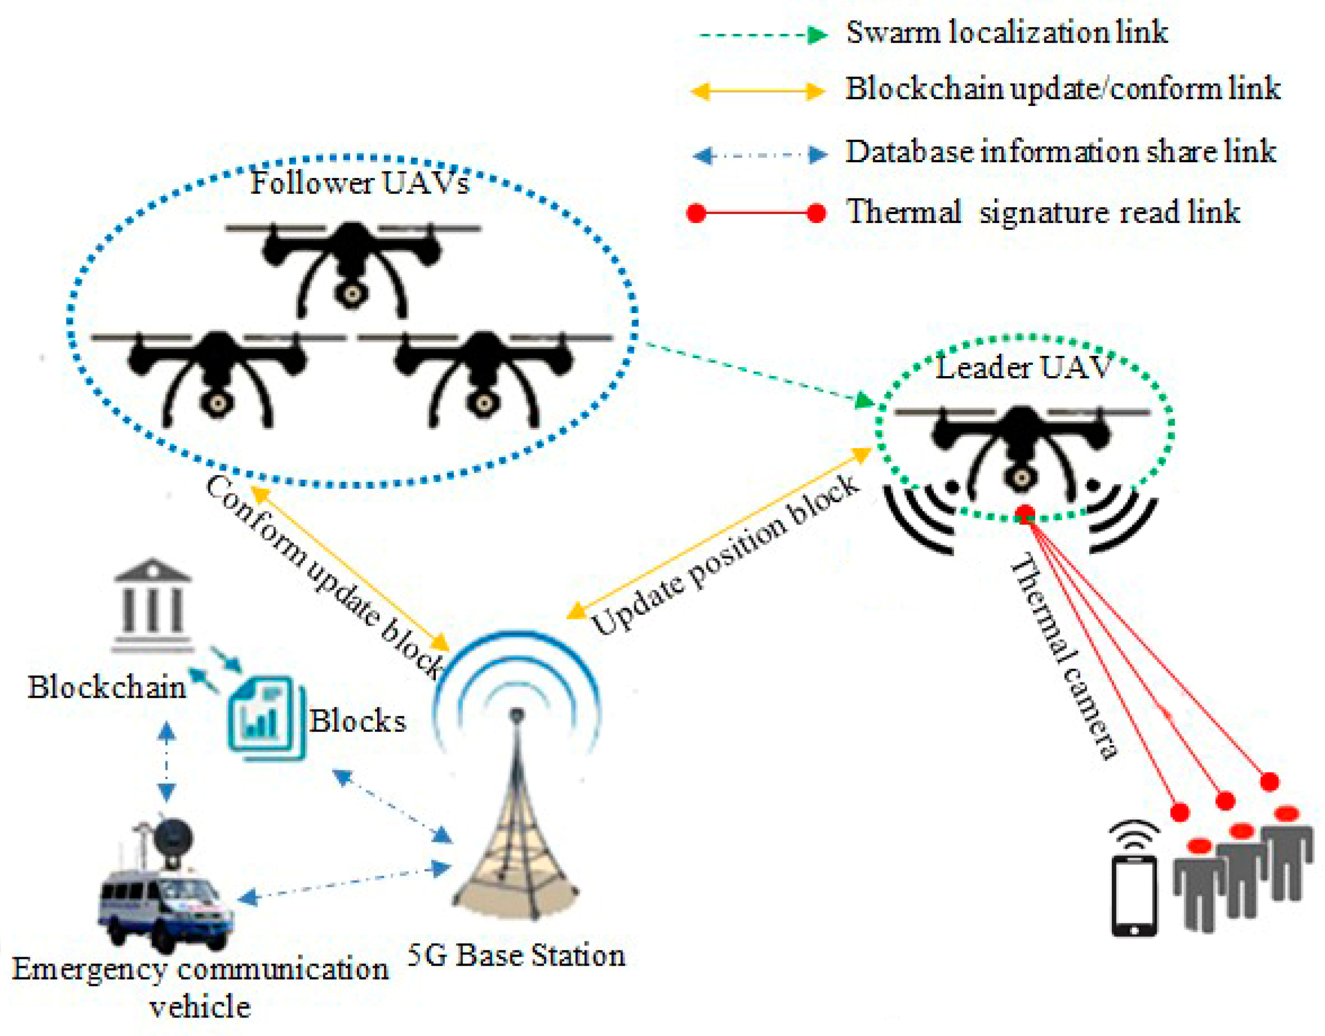
DATA TRANSMISSION
HIGH MOBILITY
Using Wi-Fi, the DJI Mavic Air 2 can send pictures and movies up to 10 kilometres away to a mobile device.
DJI Matrice 300 RTK: This device broadcasts 1080p video up to 15 km distant using cellular networks, such as 4G LTE or 5G, to send data over long distances.
Parrot Anafi USA: Can send 4K video up to 7 km distant using satellite communication. Uses satellite communication systems, such as Iridium, to transfer data over great distances and in remote places.

Slide 24
08.
POWER TRANSMISSION

Slide 25
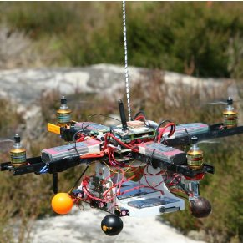
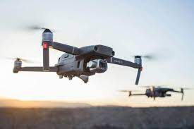
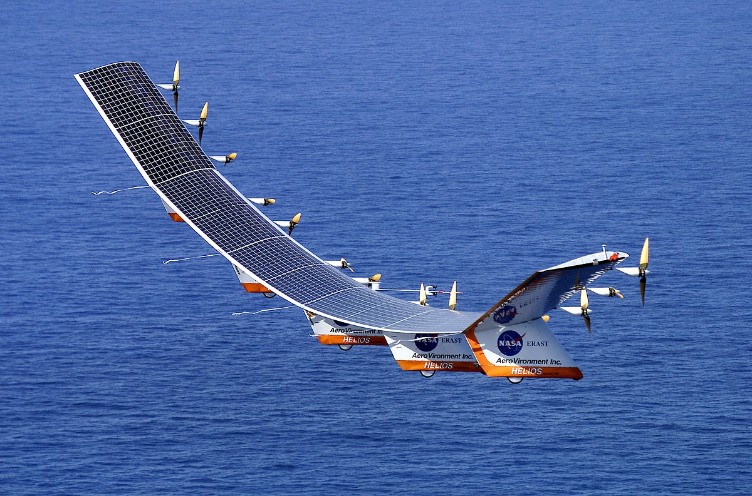
POWER TRANSMISSION
HIGH MOBILITY
Hybrid Power: NASA Greased Lightning is combined with battery-powered electric motors and a gasoline engine for propulsion
Battery Powered: DJI MAVIC 2 produces no emission and pollution
Solar Powered: NASA Helios is environmentally friendly and can provide unlimited flight times in sunny conditions

